Slide 1

Team Members:
Asheesh Kumar Singh – TLP0008
Muskaan Walia – TLP0020
Pranav Satheesan - TLP0024
Subandhu Agravanshi - TLP0034
Suvrojyoti Paul - TLP0036

Slide 2
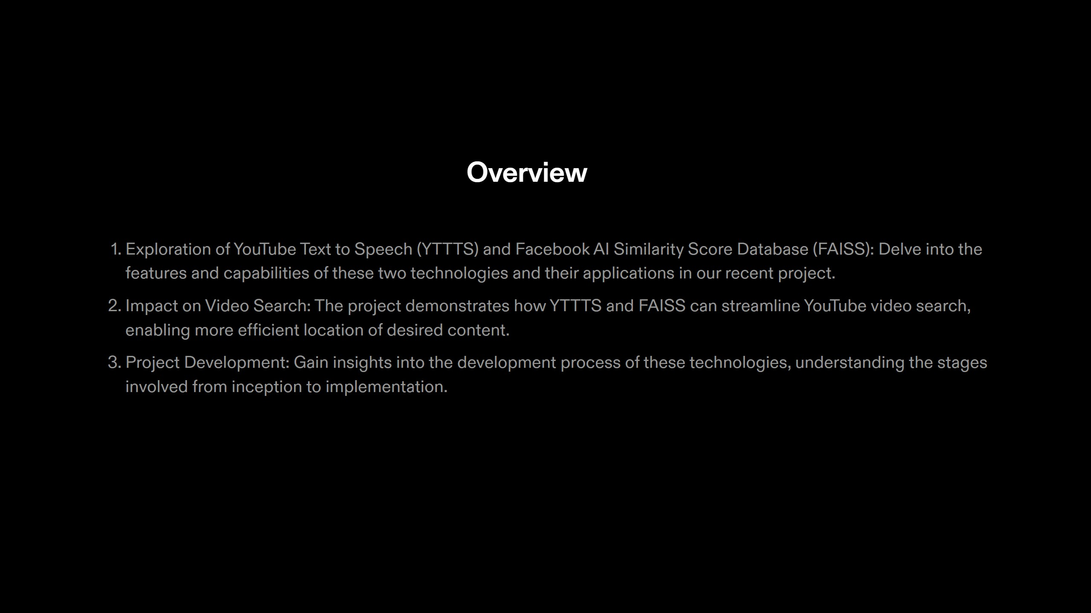

Slide 3
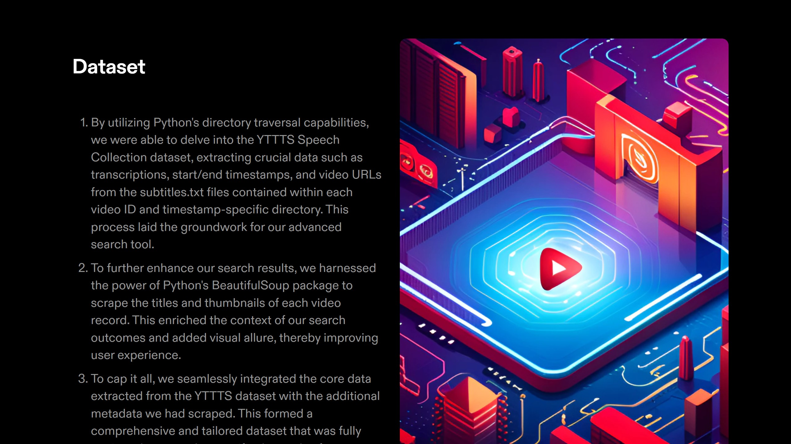

Slide 4
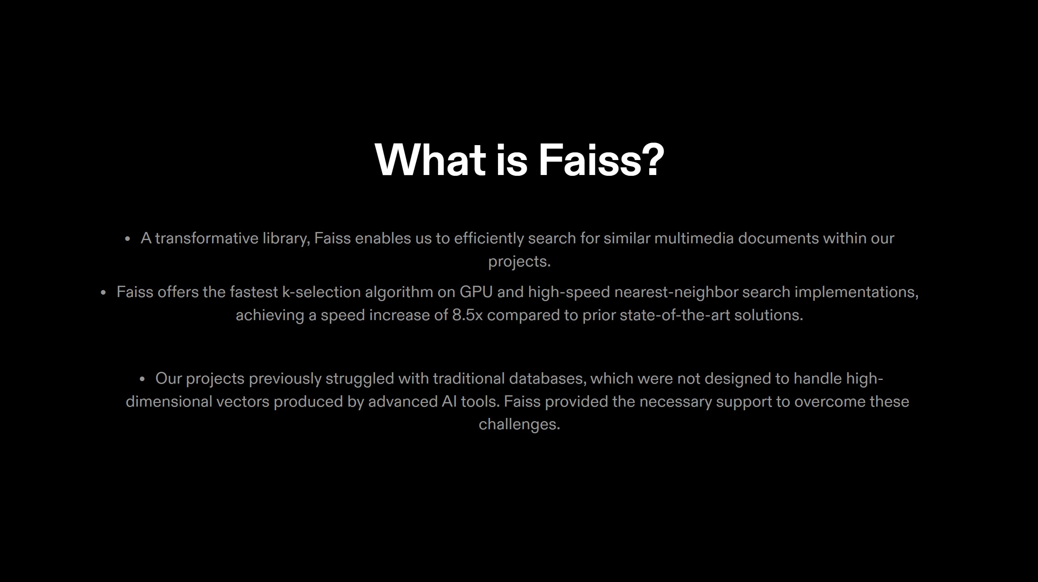

Slide 5
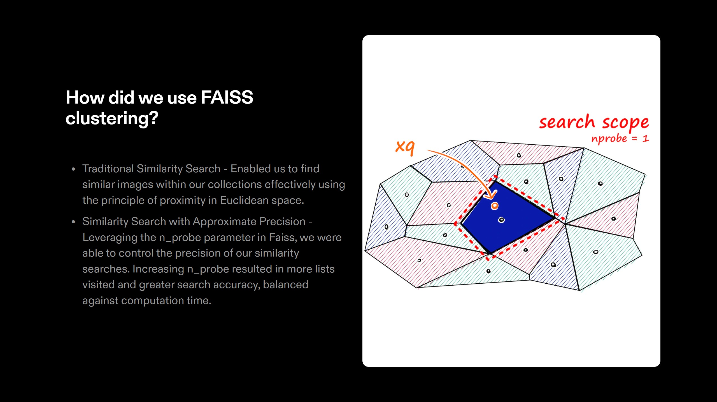

Slide 6
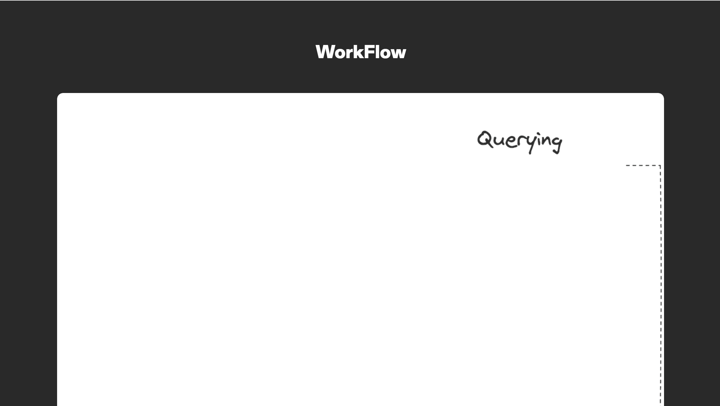
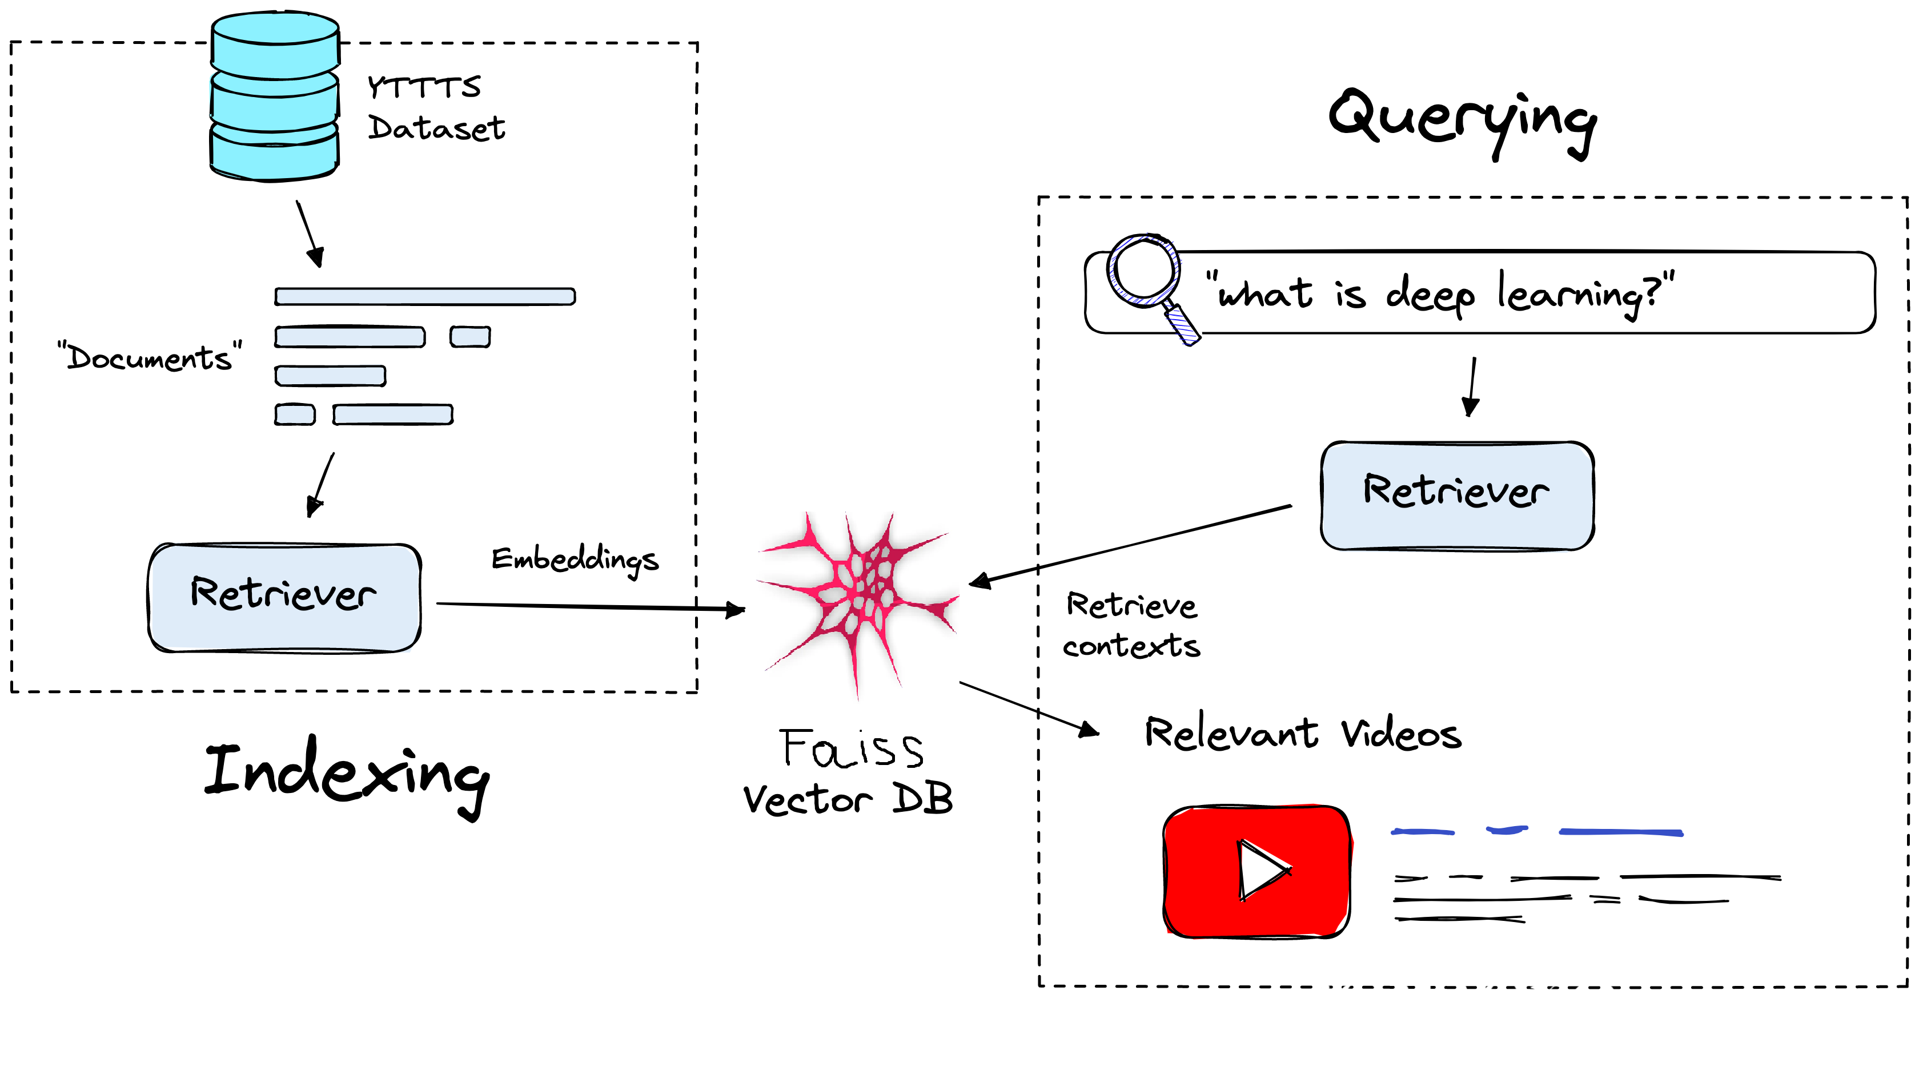




Workflow
_{r}I ₋₋₋₋₋₋₋₋₋- - - - - - - - - - - - - - - - ,
:
:
YTTTS
bo..to..se.t
:
:
I
\
----------- ----- ----- ------ -­-------
' rS"wh<>.t is cleep le""""' " 5'?"
J----- [ Retriever J
J
CJ
D .----
I
( Retriever
J-EW_lbeJc;{il'\ _s---1.........
1 Re.trie.ve.
I COl'\texts
_ _ _ _ _ _ _ _ _ _ _ _ _ J
I
I
- - - - - - - - - - --- - - - -
rcxjss
Vee.tor :DB
Rel ev°'t Videos
--
--

Slide 7
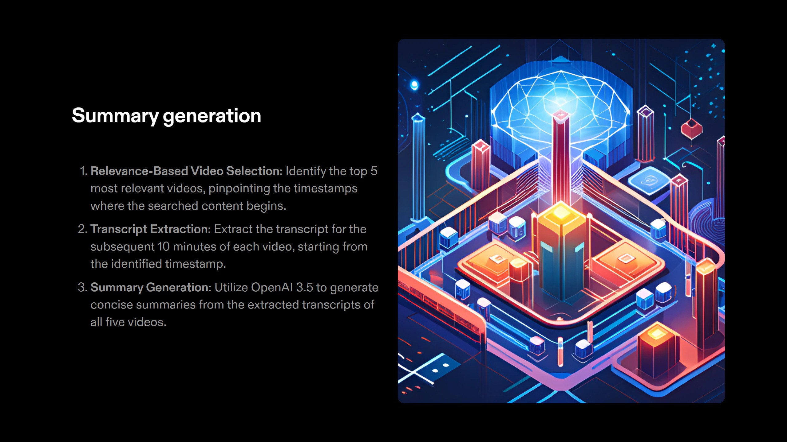

Slide 8
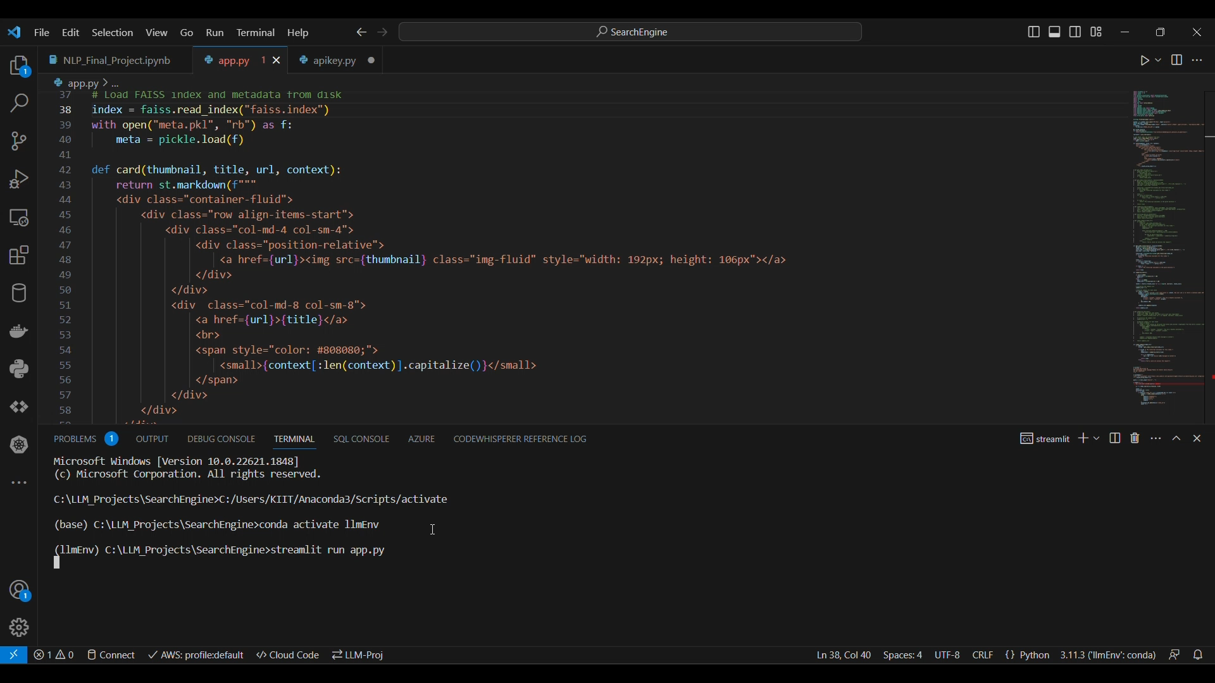


Slide 9
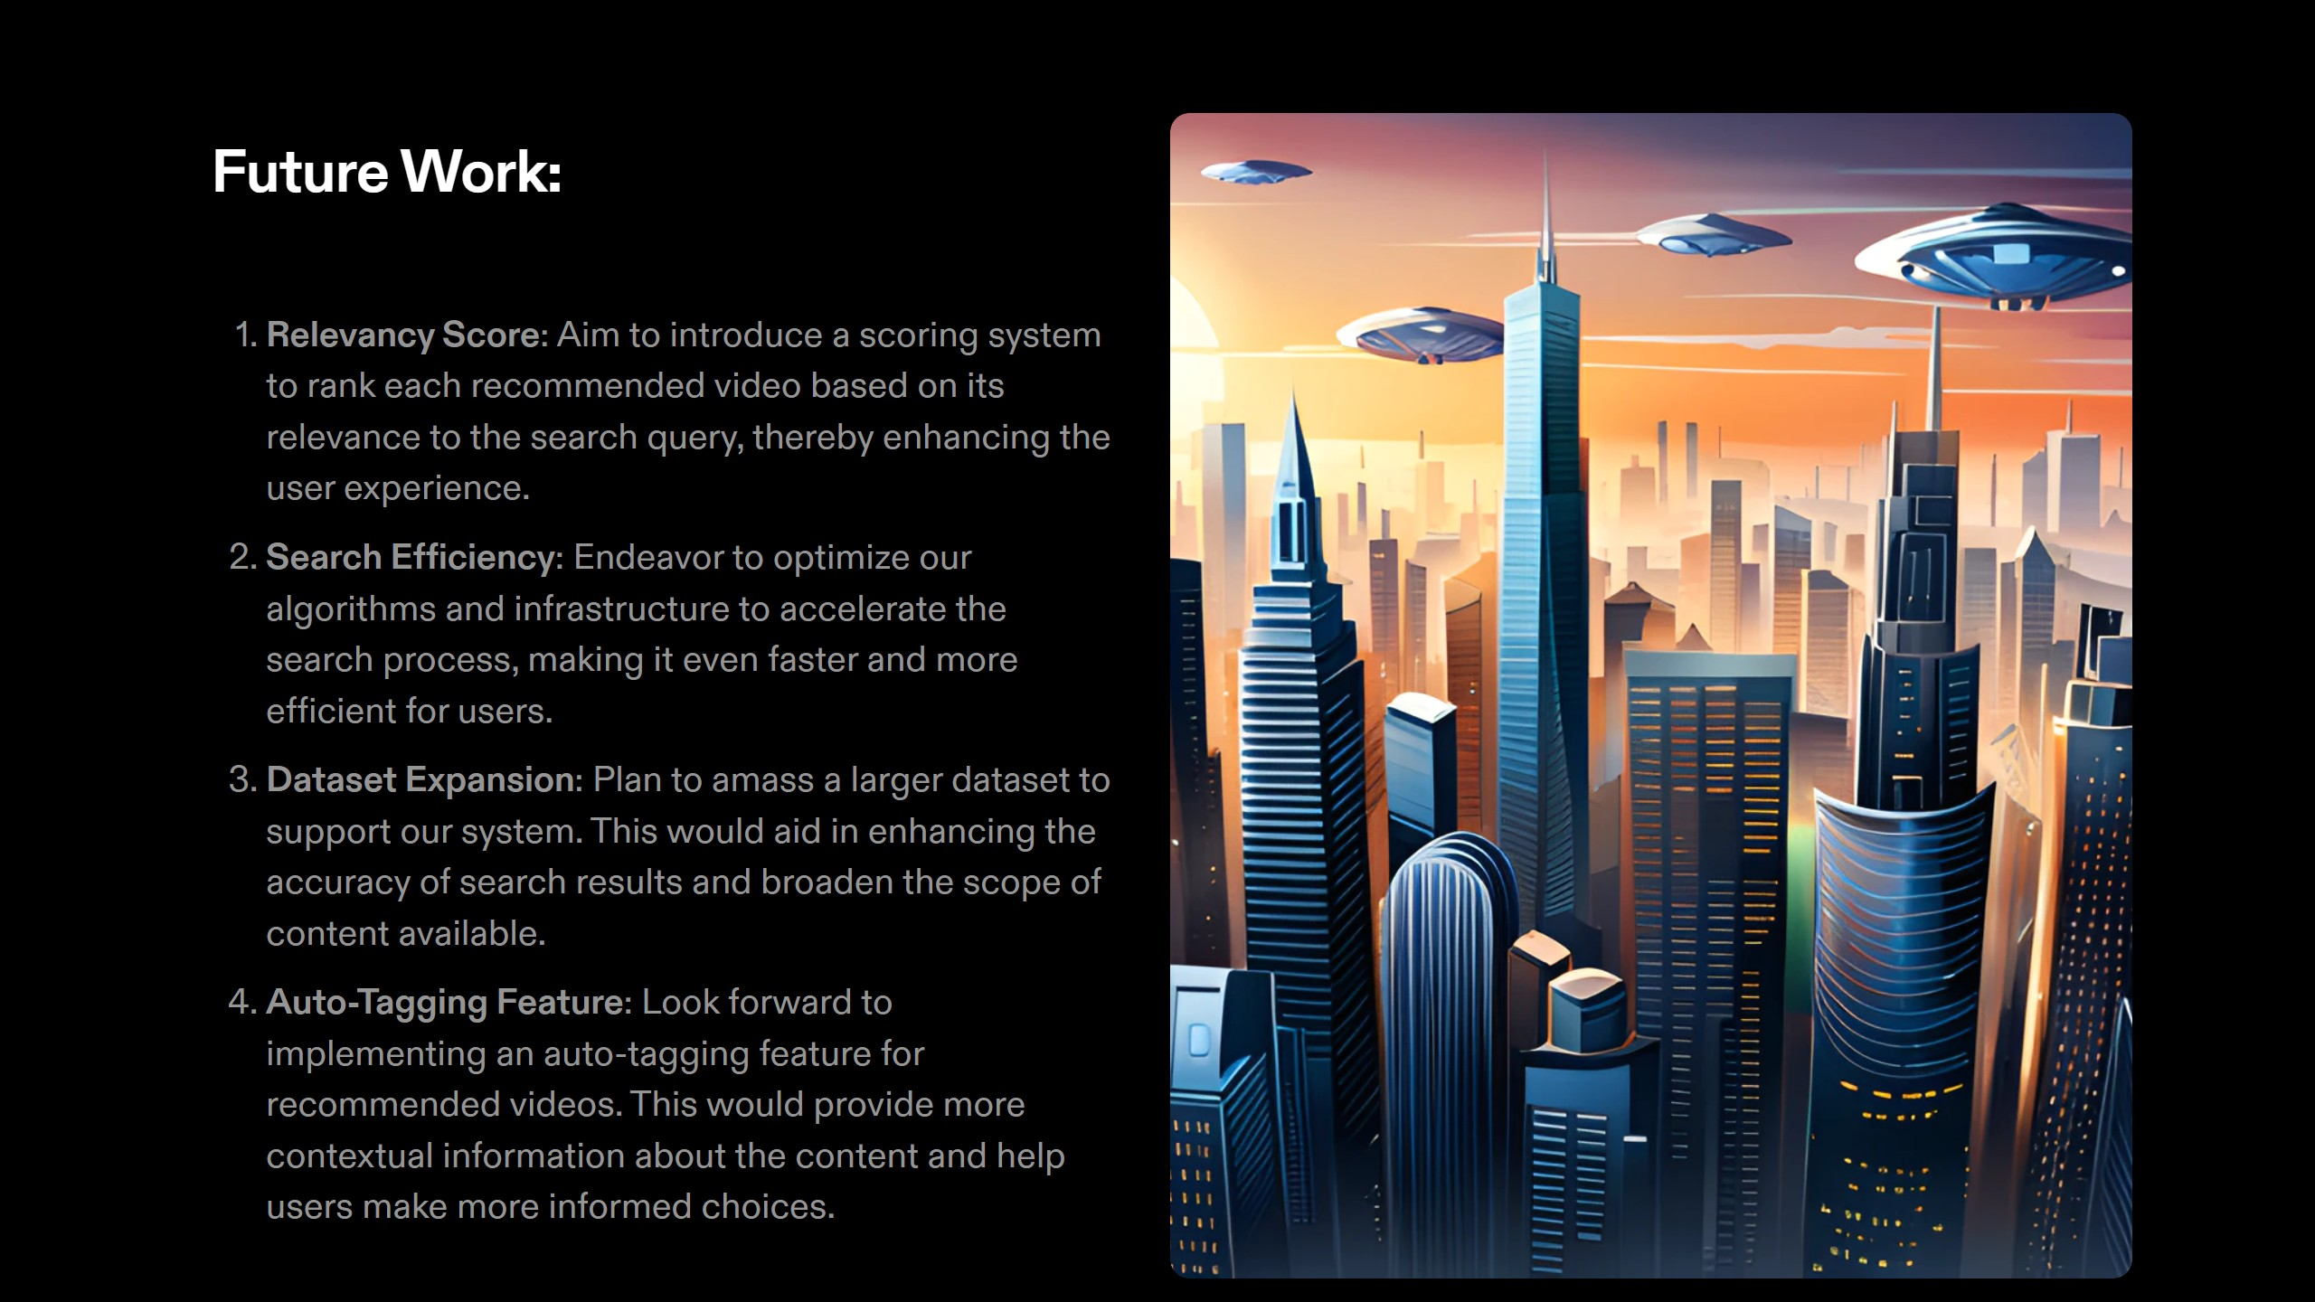

Slide 10


